Slide 1
Notes:
Required cover slide

Slide 2
Device Integration Showcase & Panel Discussion
Craig Scott
Managing Partner, Cumulus Consulting
Mike Medwith
Director of Development, Cumulus Consulting
Grant Acheson
Integration Project Manager, Cumulus Consulting
Notes:
Logo may be added to title and thank you slides only

Slide 3
Session Overview
About Cumulus Consulting
Why Integrate? What are the benefits?
About Our Solutions
What to Look For in a Solution
Some Examples and Use Cases
Discussion

Slide 4
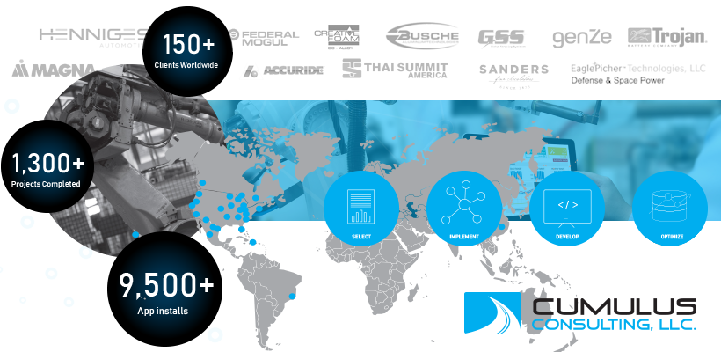
About Cumulus Consulting
Founded in 2014
Plex Accredited Solutions, Development & Service Providers
Over 150+ Plex Clients Worldwide
1,300+ Projects Completed
9,500 App installs for Plex
Custom Development
Machine/PLC Integrations
B2B/B2C Integrations
Certified Inductive Automation/Ignition Integrators
In-House Software/Mobile Development Teams
Managed IT Services for Manufacturers

Slide 5
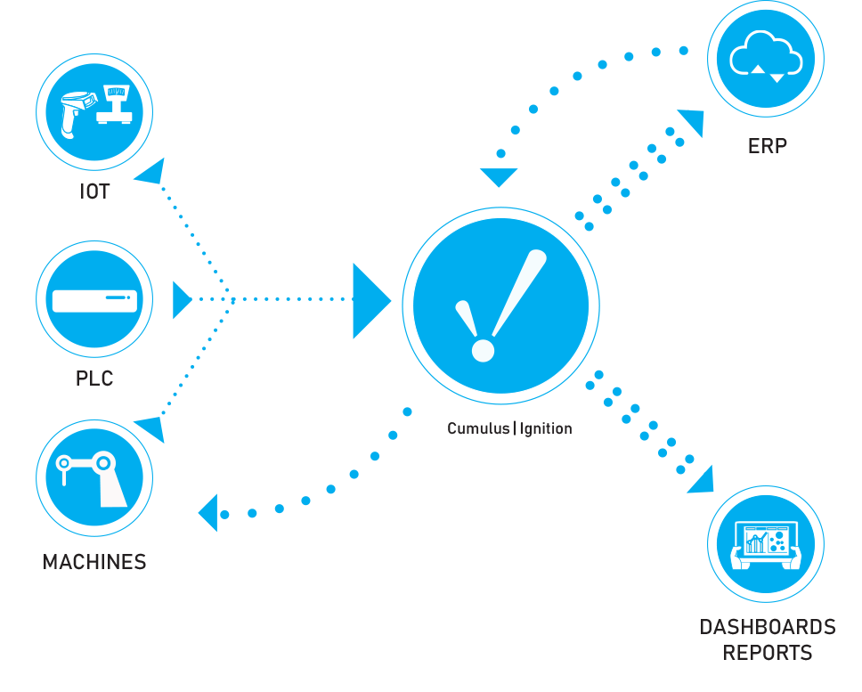
Why Integrate Machines? What Are The Benefits?
Real time data collection and analysis
Reduce costs
Reduce downtime
Increase efficiency / OEE
Make data driven decisions
Grow your business, Great customers know what great suppliers are capable of

Slide 6
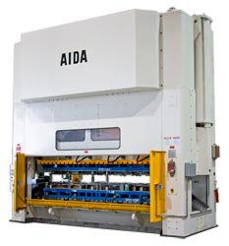
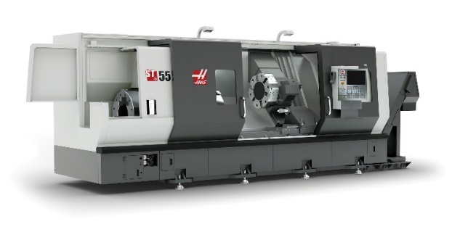
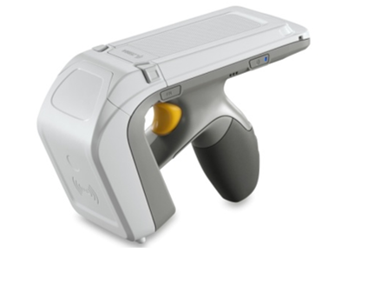
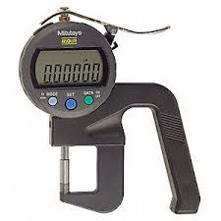
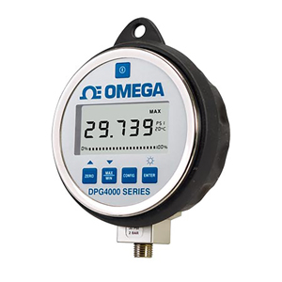
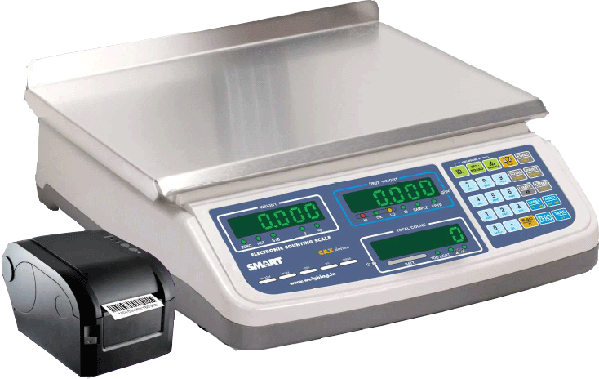
Device Connectivity
Quickly add devices
Thermometers
Weigh Scales
Stamping Presses
CNC Machines (Haas, Mazak, etc.)
Inspection Gages
Bluetooth Scanners
Connect Anything

Slide 7
Case Study Highlights
RFID
RFID Inventory Management
PLC Integration
Light guided inspection, instructions and
Machine Vision

Slide 8
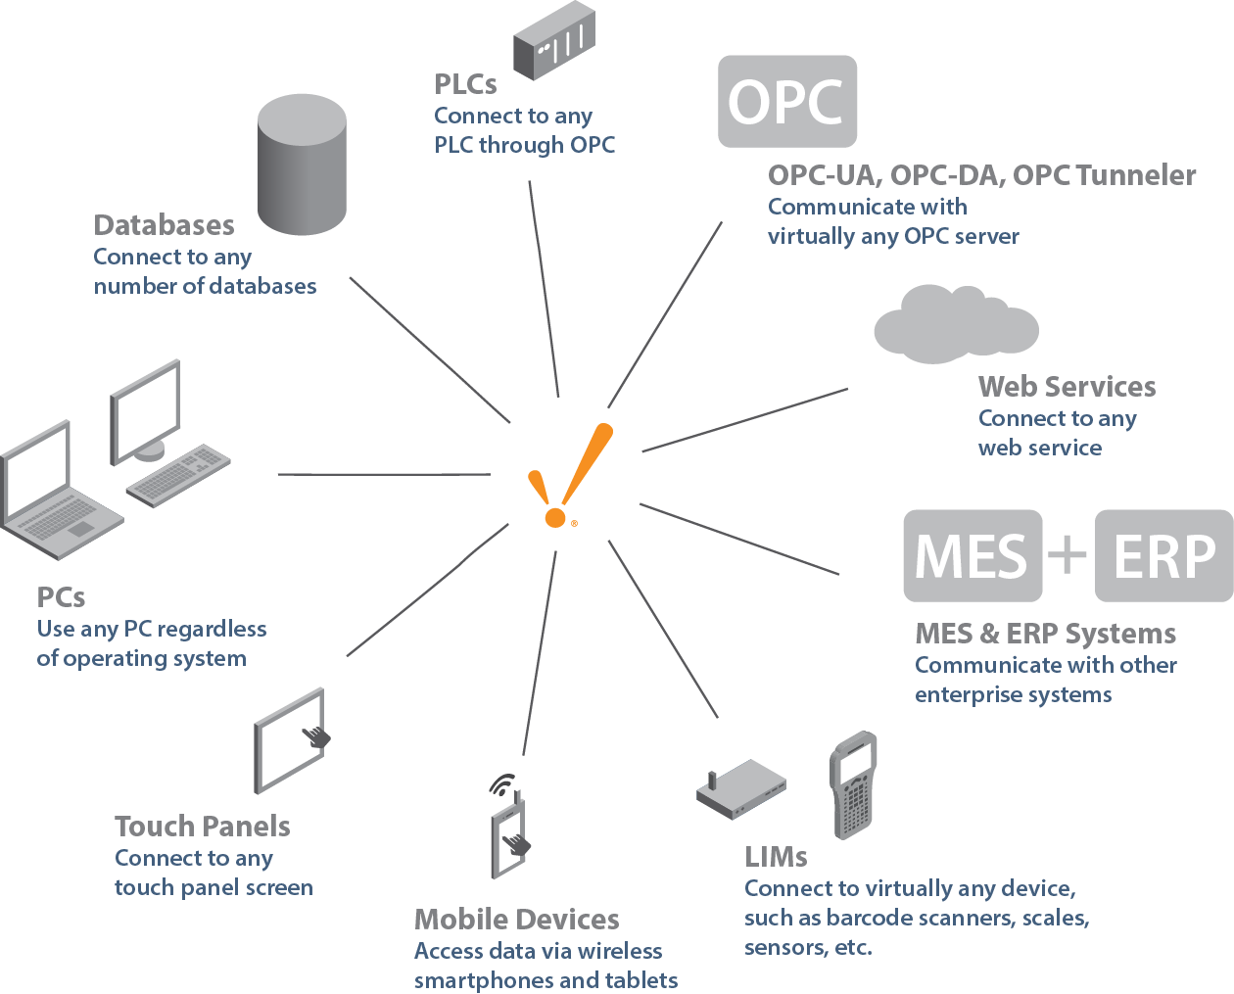
Integration Solutions
On-premise or cloud
Scalable
Enterprise
Easy to Use
Full SCADA
HMI Screens
Dashboards
OPC/UA Server Built In
Historian
Unlimited Tags/Clients
Connect to Anything
Free Training
Global Support
Try Before You Buy

Slide 9
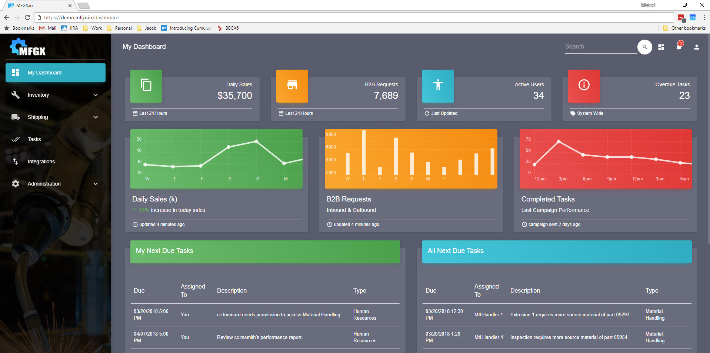
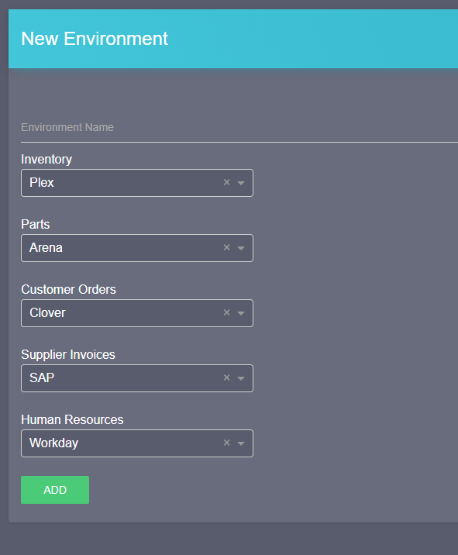
Integration Solutions
Cloud Multi-tenant Solution
Supports integration between ERP and “Anything” else
E-commerce / Point of Sale
Machine / PLC Integration
Business intelligence
PLM
CAD/CAM
Payroll

Slide 10
Case Studies
RFID
RFID Inventory Management

Slide 11
CASE STUDY – RFID Inventory Management
PROBLEM
Inventory accuracy was poor
Human errors during receiving/put-away
Order fulfillment problems
Increased expediting expenses
Excessive Cycle Counting
Loss of productivity and profit margins
RFID

Slide 12
CASE STUDY – RFID Inventory Management
GOALS
Higher accuracy during inventory cycle counting
Improved traceability of product
Clearer inventory visibility
Improve customer satisfaction and delivery
Seamless integration with PLEX
Hands free operation of inventory transactions for material handlers
RFID

Slide 13
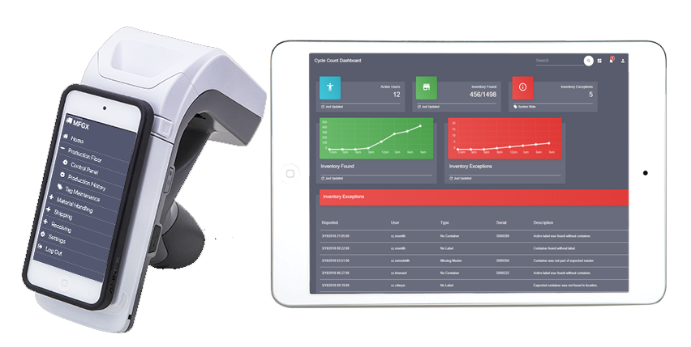
CASE STUDY – RFID Inventory Management
THE SOLUTION
RFID

Slide 14
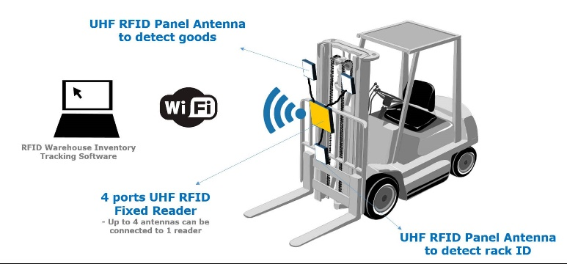
CASE STUDY – RFID Inventory Management
HOW IT WORKS
RFID

Slide 15
CASE STUDY – RFID Inventory Management
THE RESULTS
>99% Inventory Accuracy
Savings of Ten of Thousands every month with more efficient inventory tracking
Cycle counting reduced by 30%, approx. $18k savings/month
Increased Customer Satisfaction and On-Time Delivery
Future enhancements
Drone attached RFID equipment for un-manned cycle counting
Shipping automation – dock transfer via RFID
RFID

Slide 16
Case Studies
PLC Integration

Slide 17
CASE STUDY – PLC Integration
PROBLEM
Multiple Work Centers in a Cell Configuration
Impossible to record production or scrap manually
Impossible to determine status of individual machines
Added complexity of multi-out production
OEE and downtime codes could not be measured accurately

Slide 18
CASE STUDY – PLC Integration
GOALS
Automate recording of production and consumption of source inventory based on cycle time
Determine OEE & downtime reason at the machine level based on PLC status
Simplify and combine HMI and ERP interface
Reduce hardware costs for new ERP implementation

Slide 19
CASE STUDY – PLC Integration
SOLUTION
Using Ignition and MFGx, automated the process of recording production and machine status monitoring
Developed custom HMI screens for operators to combine machine interface and PLEX functions
Developed OEE reporting using combined data sources from PLEX and Ignition
Automated “setup” process in PLEX by utilizing tagged tool data to ensure PLC, ERP and physical tooling were all coordinated

Slide 20
CASE STUDY – PLC Integration
THE RESULTS
Achieved OEE visibility at the machine, department and plant level
Improved WIP and RAW inventory accuracy
Resolved issue of multi-out inventory tracking
Reduced ERP hardware spend by $80k
Reduced training required to go live
Future enhancements
CNC Machining Operation
Weigh Counting
Global reporting of OEE

Slide 21
Case Studies
Light Guided Inspection, Instructions and
Machine Vision

Slide 22
CASE STUDY – Light Guided Inspection, Instructions & Machine Vision
PROBLEM
Manual Inspection and assembly processes are not controlled
Difficult to train new associates
Operator dependent processes are costly and inefficient
Impossible to capture actual cycle times
Operators always find what they think is a “better way” leading to quality issues

Slide 23
CASE STUDY – Light Guided Inspection, Instructions & Machine Vision
GOALS
Ensure 100% compliance with inspections
Fully repeatable operator steps every time
Capture cycle times and labor costs
Integrate with PLEX for record production, workcenter status, record scrap
Virtual buttons on work surface for HMI appear based on step in the process
Replace paper based work instructions for manual processes
Reduce training time for new staff

Slide 24
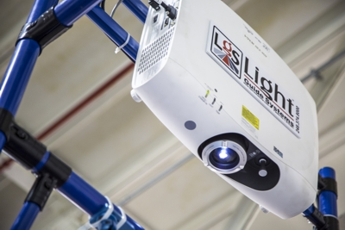
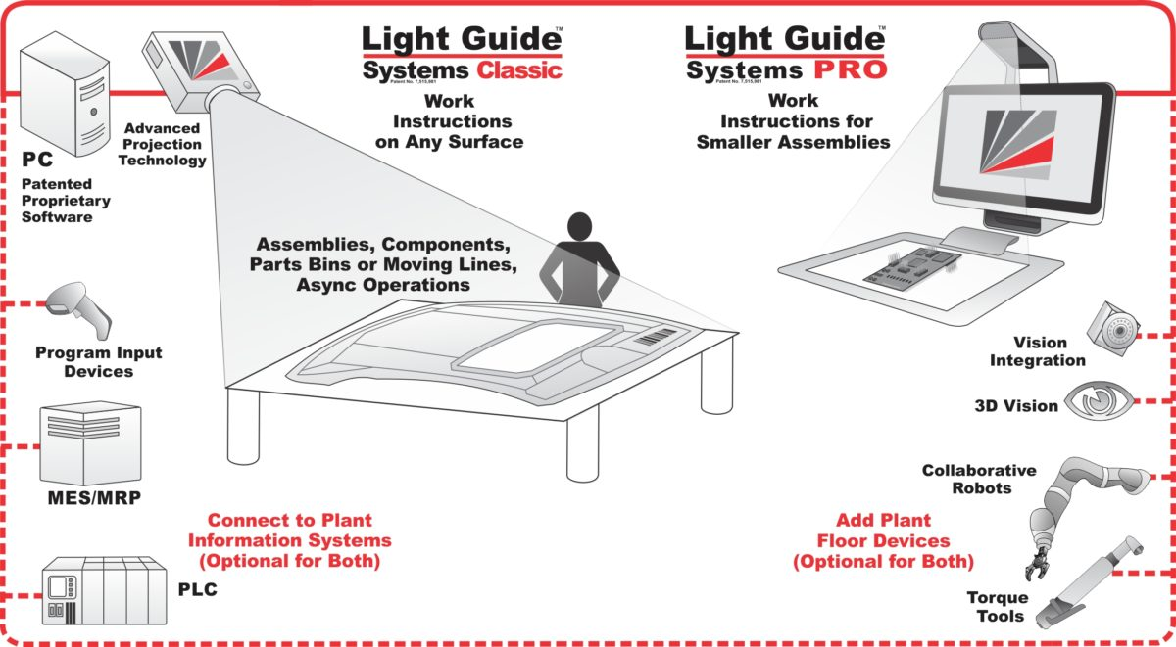
CASE STUDY – Light Guided Inspection, Instructions & Machine Vision
THE SOLUTION
Custom Light Guide Systems with seamless integration to PLEX control panel via MFGx
Overhead projector with integration machine vision and 3D camera
Integrated assembly equipment (torque wrench, calipers, thread gages, etc.) with feedback to PLEX checksheets
Augmented reality with real 3D sensing

Slide 25
CASE STUDY – Light Guided Inspection, Instructions & Machine Vision
HOW IT WORKS
Light Guide System verifies each step is completed in the proper sequence and according to specification
Machine vision cameras perform inspection simultaneously
Once step is completed and verified the next step is projected
Once all steps are completed 100% the system will project a record production button which records the transaction in PLEX
Scrap and Status buttons allow the operator to easily update status in real-time

Slide 26
CASE STUDY – Light Guided Inspection, Instructions & Machine Vision
THE RESULTS
100% Process compliance with little to no training
Now capturing actual cycle times, have seen 57% improvement
Realtime Inventory transactions/visibility via ERP integration
Huge cost savings compared to traditional hard fixturing
Inspection fixture and template elimination
Reduced costs from $50-150k range per fixture, are now $5-15k
Program change over is as simple as a program change on our HMI
New tooling lead time reduced from 15-20 weeks, to just 1-3 weeks
Ability to capacity plan manual operations and compare to standards

Slide 27
OTHER APPLICATONS

Slide 28
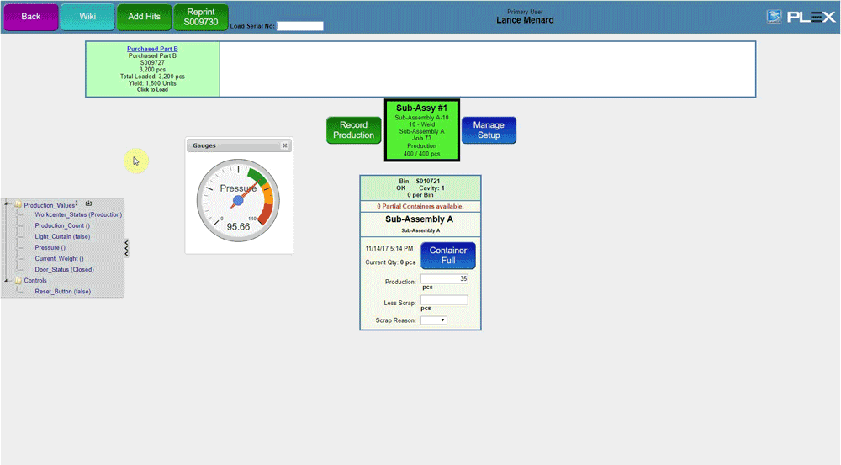
IoT Bridge
Drag and drop tags
2 way communication
Add buttons
Add charts
Add Gauges

Slide 29
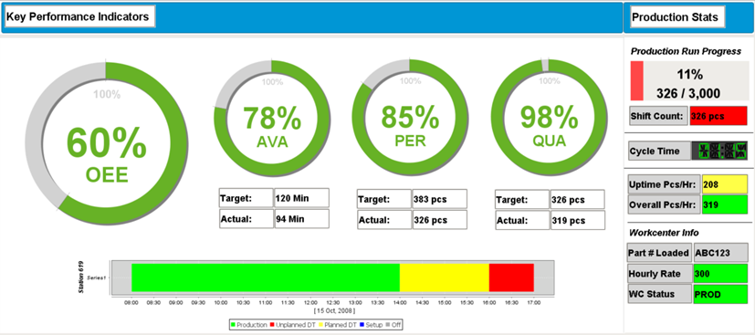
Real-Time Dashboards

Slide 30
Key Takeaways
Real time data collection and analysis
Reduce costs
Reduce downtime
Increase efficiency / OEE
Make data driven decisions
Grow your business, Great customers know what great suppliers are capable of

Slide 31
Thank You!
info@cumulus-erp.com
www.cumulus-erp.com
Notes:
Logo may be added to title and thank you slides only

Slide 32
PLEX SYSTEMS, INC. PRIVILEGED AND CONFIDENTIAL INFORMATION.
Copyright ©2018. Plex Systems, Inc. All Rights Reserved.
PERMISSION TO COPY, MODIFY, AND/OR DISTRIBUTE THIS DOCUMENT WITHOUT THE PRIOR WRITTEN CONSENT OF PLEX SYSTEMS, INC. IS STRICTLY PROHIBITED. NO PART OF THIS DOCUMENT MAY BE REPRODUCED, STORED IN A RETRIEVAL SYSTEM, DISSEMINATED, OR TRANSMITTED IN ANY FORM OR BY ANY MEANS, ELECTRONIC, MECHANICAL, PHOTOCOPYING, RECORDING, OR OTHERWISE, WITHOUT THE PRIOR WRITTEN PERMISSION OF PLEX SYSTEMS, INC.
Notes:
Required final slide

